Slide 1


Smart security system
IoT fundamentals
Review

Slide 2
Team
Pavan Sri Ram Basava
(19BEC0423)
Tarun Vijay Kumar Polepalli
(19BEC0848)
Muthyalapati Bhanu Prakash
(19BEC0851)

Slide 3
Abstract
Nowadays home security has been a major issue
This project’s idea is to provide security to places likes office and homes at affordable prices.
This project helps in notifying the user if there is any person waiting
This also helps in alerting the user if there is any unwanted movement is detected

Slide 4
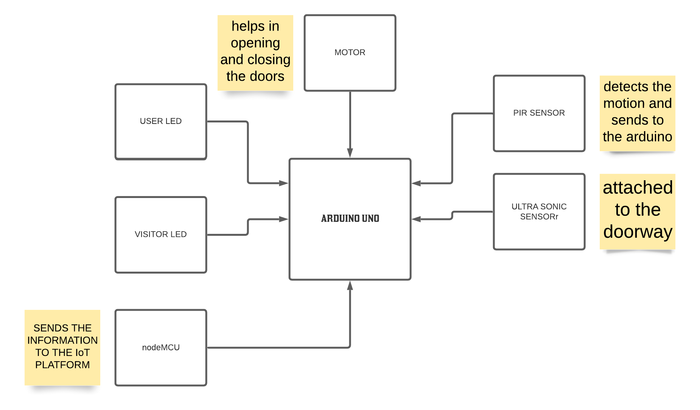
Overview of hardware components
Ultra sonic sensor
PIR Sensor
Arduino Uno
LED’s
Servo Motors
Connecting Wires
nodeMCU

Slide 5
Working process
Our project works with the combinations of different parts doing their job in sync and there goes it
Giving it a start the PIR sensor tries detecting any motion in its range and then if no motion is detected same as ever but, if any motion detected then that goes further where the ultrasonic sensor shows up
And for the ultrasonic sensor, when motion is detected and its coming near to the ultrasonic sensor which has been fitted to the door the led glows as a signal that someone/something is coming( that’s what VISITOR LED is used for).
After seeing the VISITOR LED glow, then that’s the user decision and here the nodeMCU jump in
using thingspeak combined with nodeMCU the user operate it as read info at one and write info at others, by writing the value as 0, which means the led on user side doesn’t glow so the other nodeMCU reads as 0 and wont open the door

Slide 6
Working (continued)
And when the value is written 1, the other nodeMCU reads it as 1 and opens the door
As this continues the data of the door opening and closing will be entered into the cloud

Slide 7
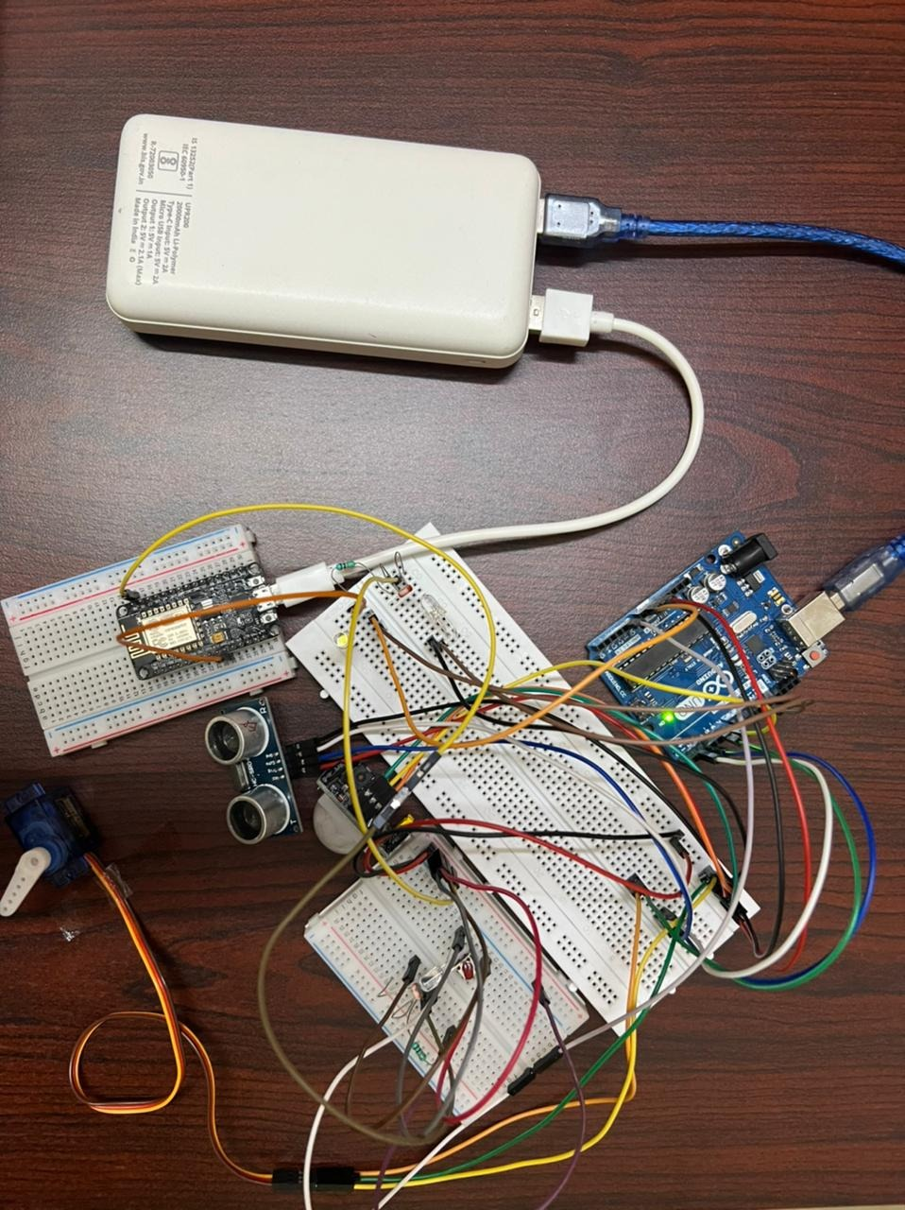
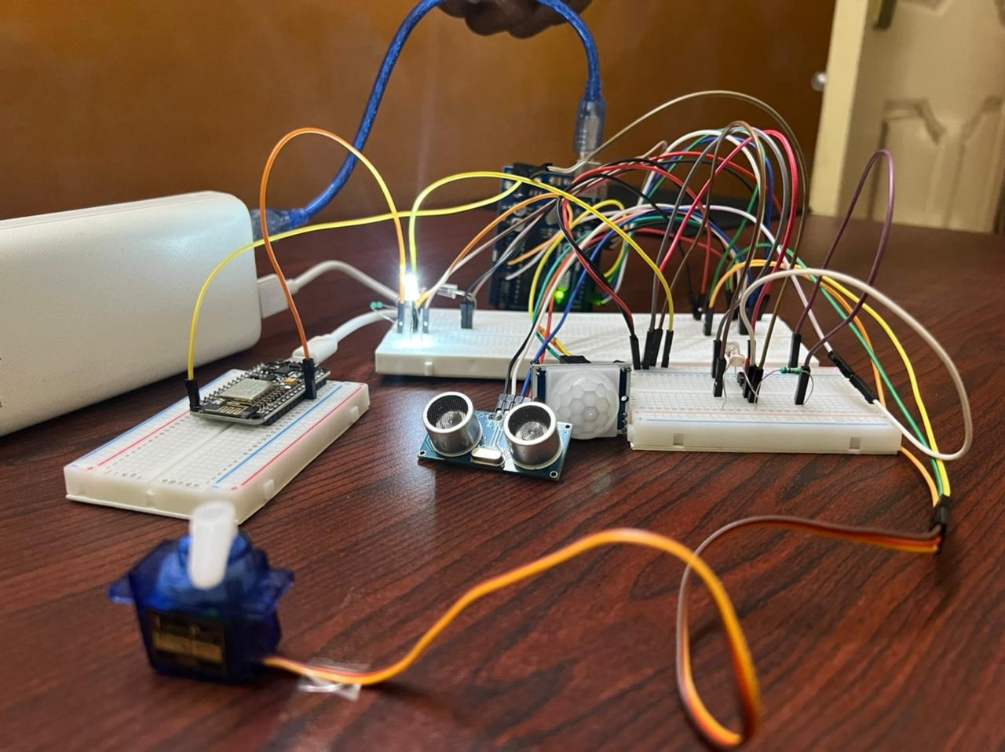
Circuit

Slide 8
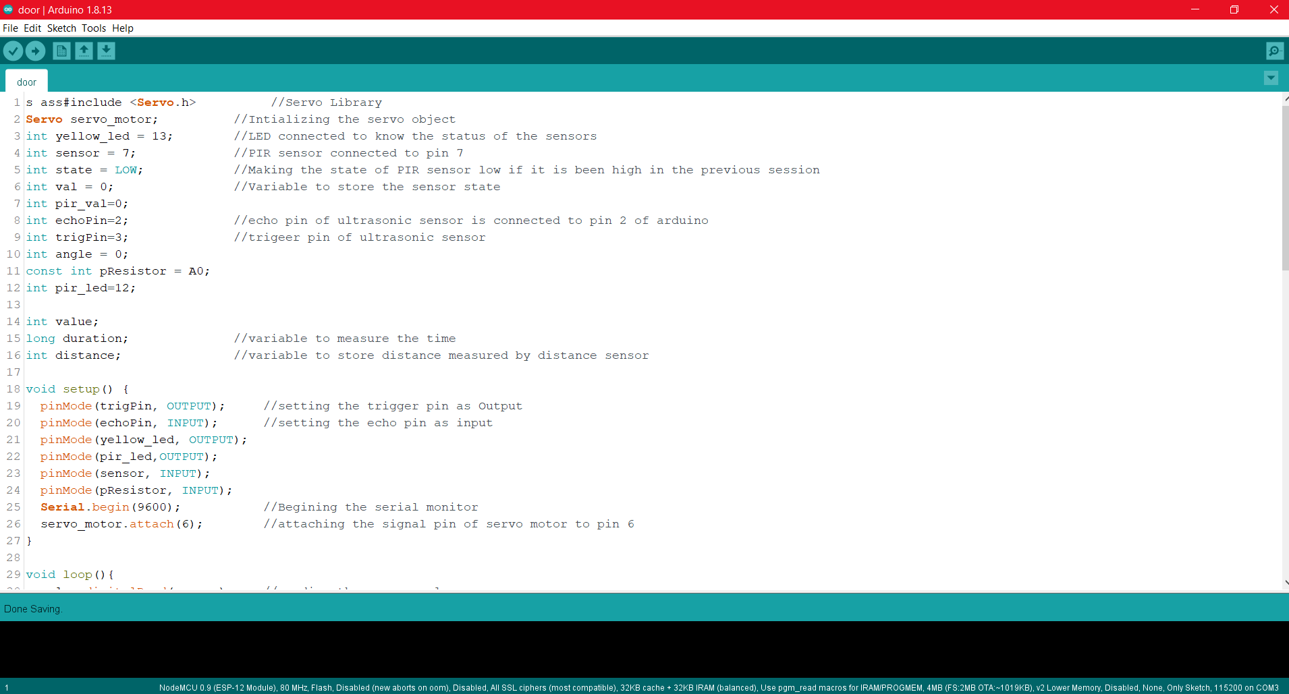
Code with comments

Slide 9
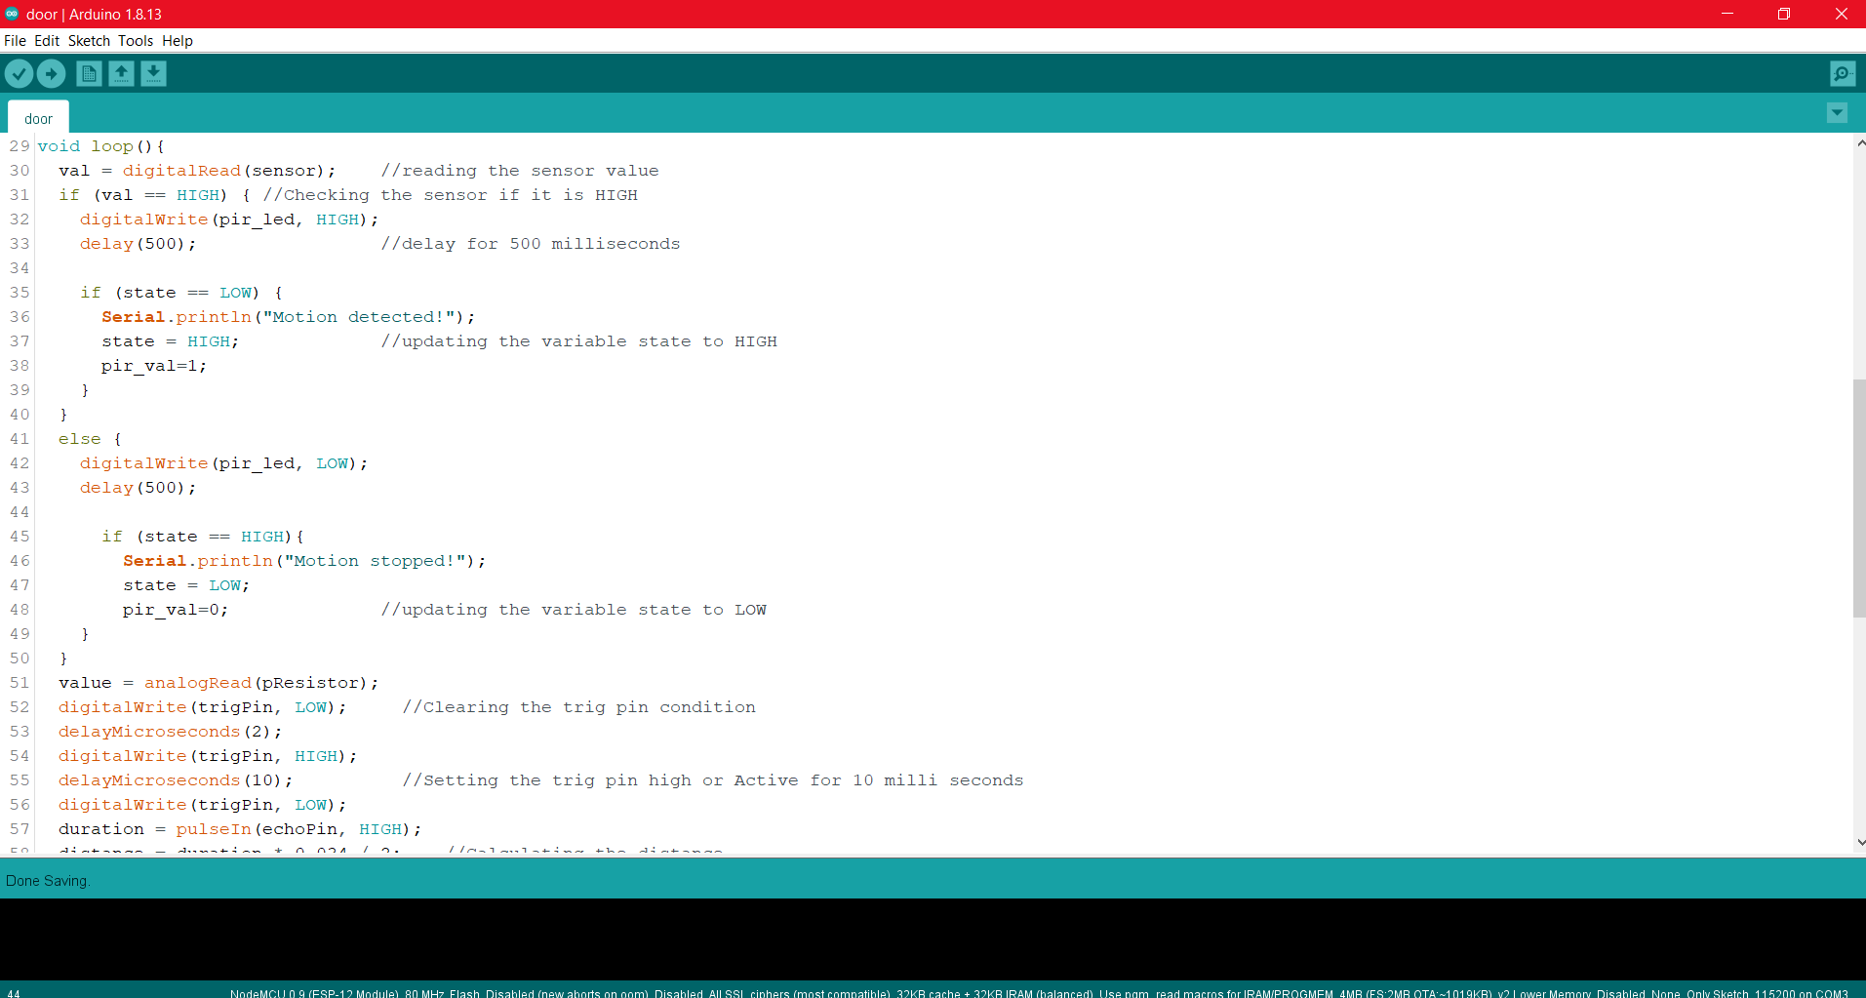

Slide 10
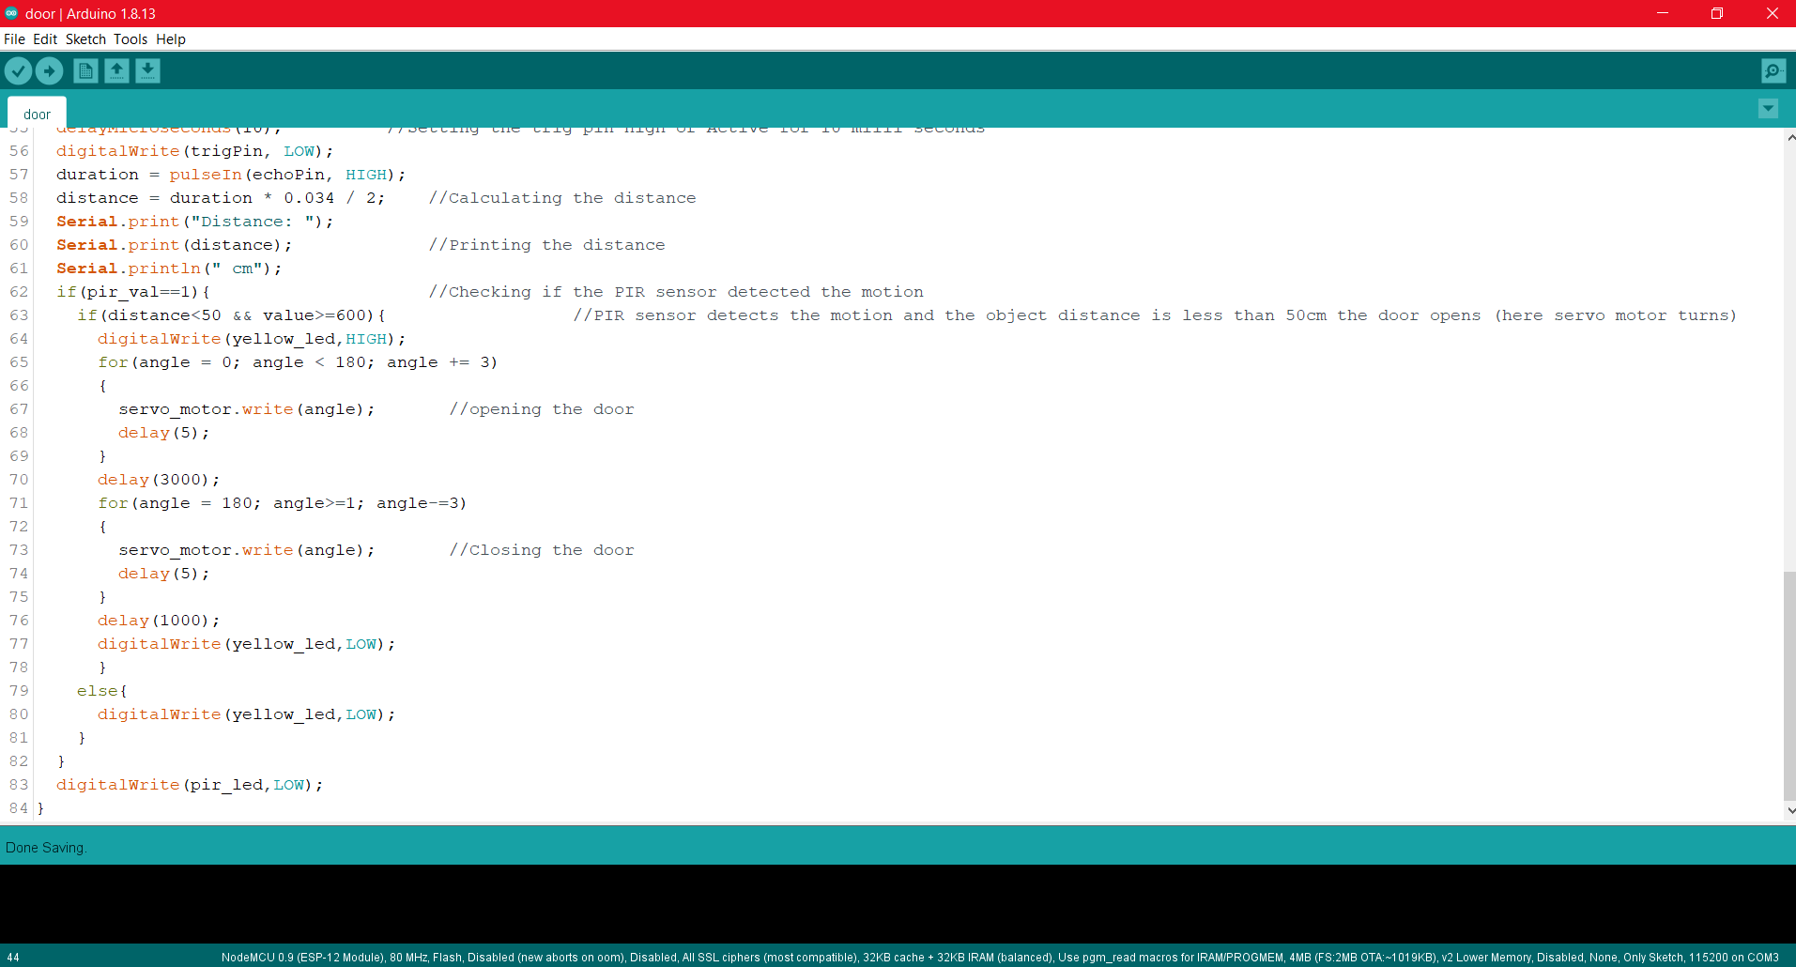

Slide 11
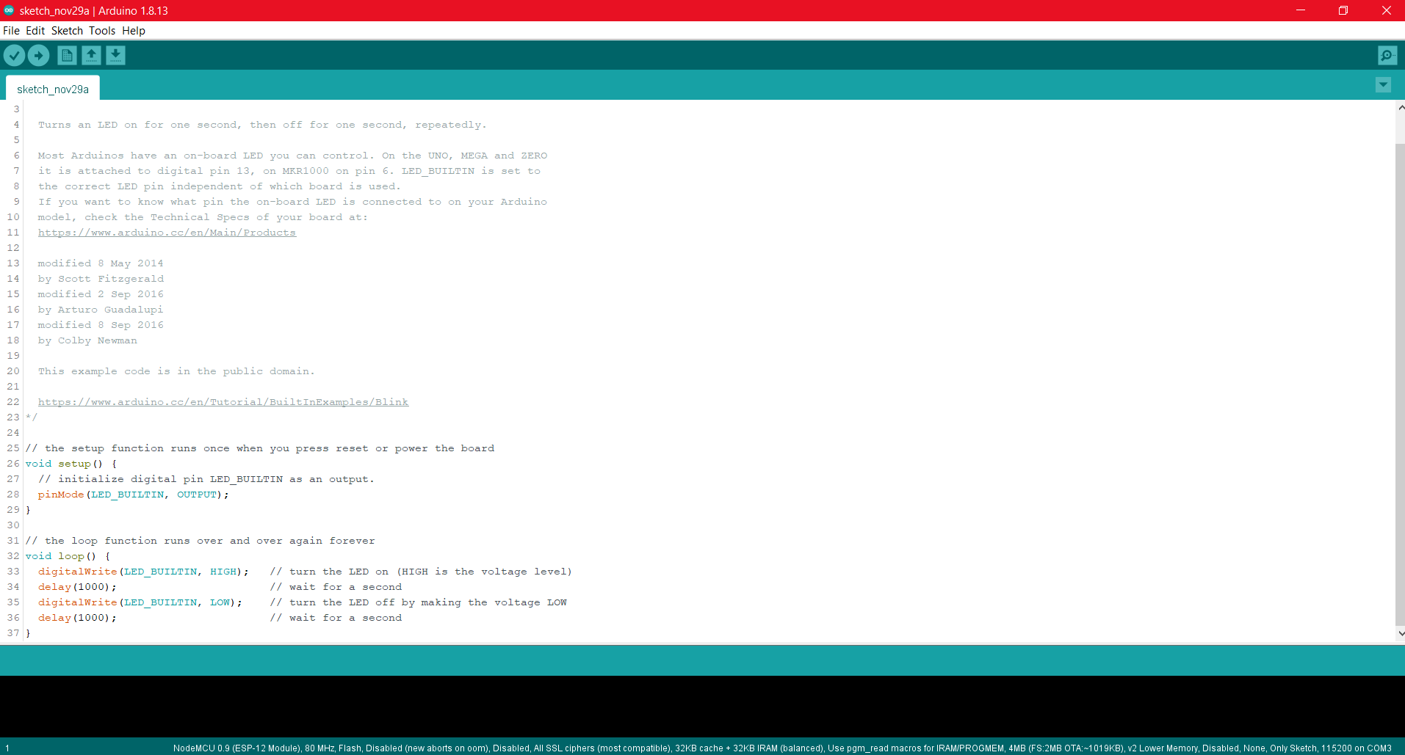

Slide 12
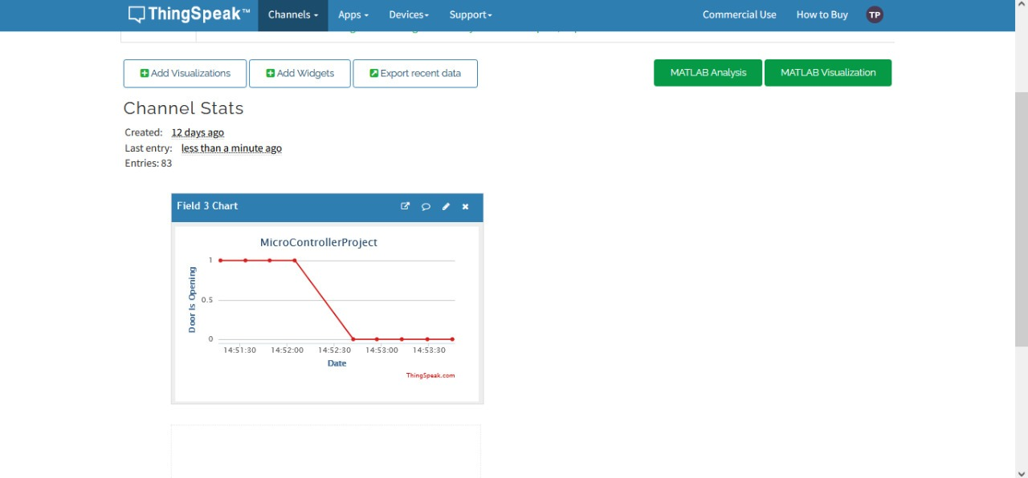
Results
Values in thingspeak

Slide 13
Conclusion
This project’s idea is to provide security to places likes office and homes at affordable prices.
This is a user friendly project
This projects is more accurate as it helps to identify the difference between a stranger passing by and someone waiting at the door

Slide 14
FUTURE SCOPE

Slide 15
References
https://ijesc.org/upload/4bdd11226f4ddc3c472cb585b0e2448b.Automatic%20Room%20Light%20Controller%20using%20%20Arduino%20and%20PIR%20Sensor.pdf
https://www.irjet.net/archives/V5/i4/IRJET-V5I41050.pdf
https://create.arduino.cc/projecthub/abdularbi17/ultrasonic-sensor-hc-sr04-with-arduino-tutorial-327ff6

